Slide 1
“AN ARMY OF CLAY”

Slide 2
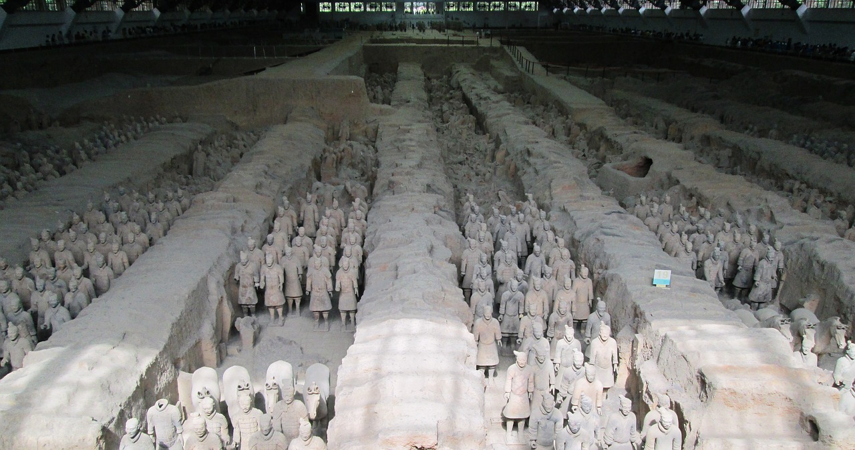

Slide 3
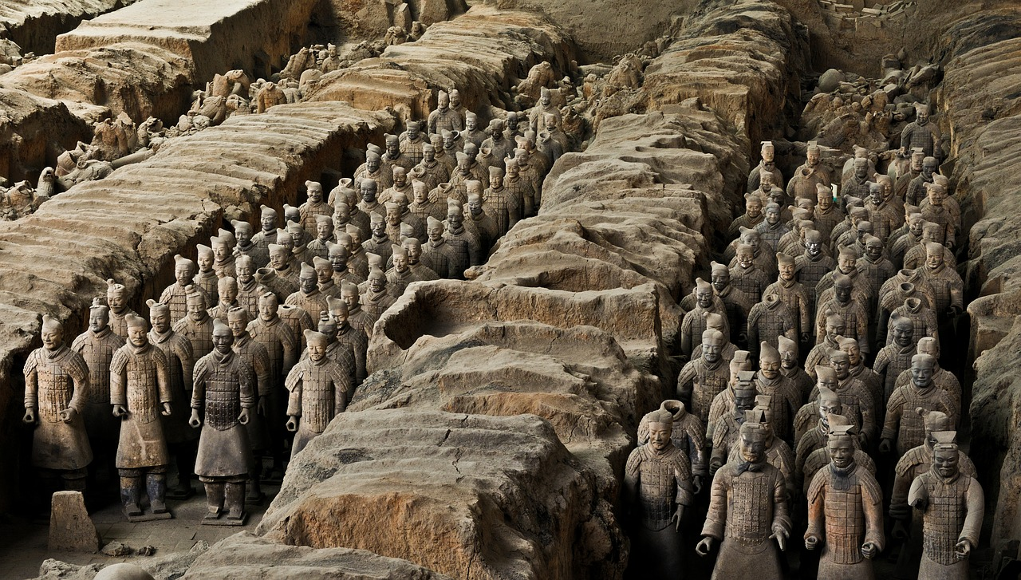

Slide 4
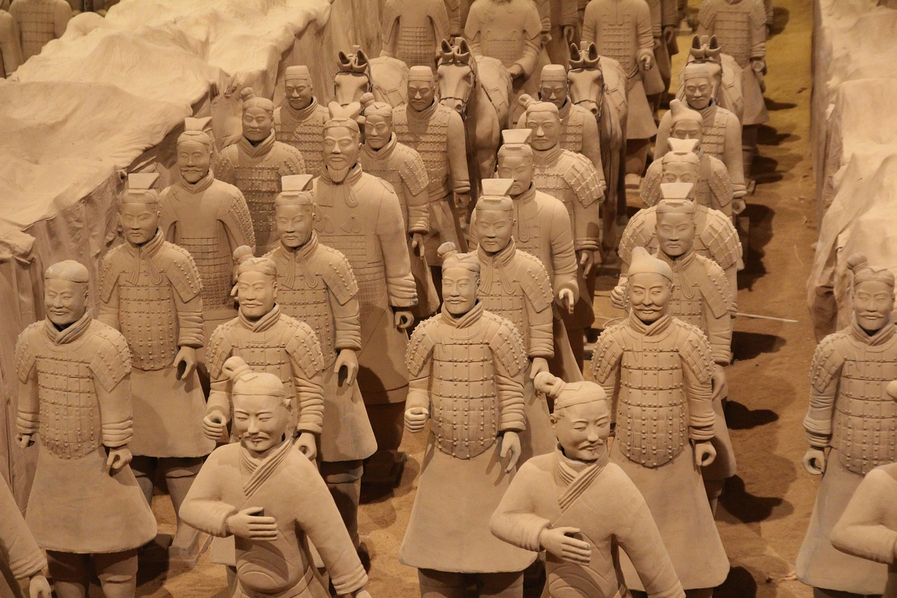

Slide 5
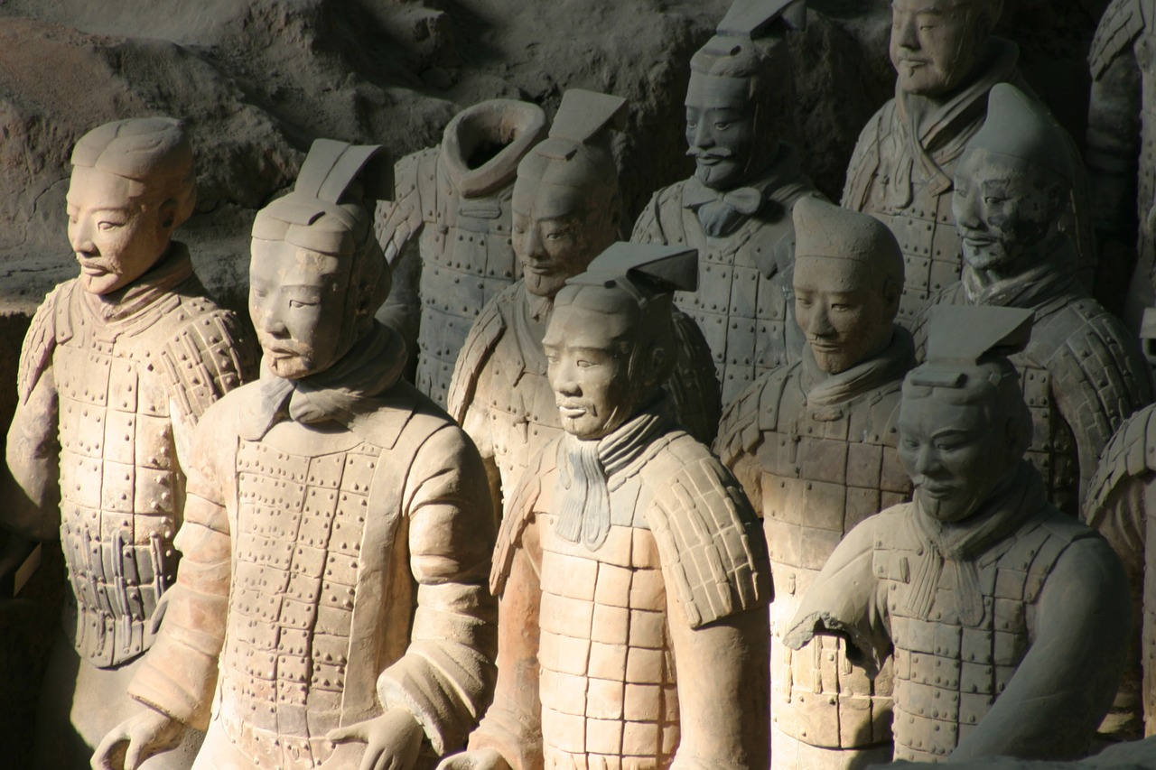

Slide 6
AN ARMY OF CLAY:
DO NOT TAKE PLANNING FOR DEATH LIGHTLY
(ECCL. 2:16; 3:2; 7:2; 8:8)
(PS. 89:47-48)

Slide 7
AN ARMY OF CLAY:
DO NOT TAKE PLANNING FOR DEATH LIGHTLY
DO NOT FORGET WHO THE CLAY IS
(JER. 18:1+) (ROM. 9:20-21)
(IS. 64:8) (II TIM. 2:20-21)
(ROM. 14:8)

