Slide 1
“NATIONAL PROPHECIES”

Slide 2
NATIONAL PROPHECIES:
(DAN. 2:31-45) – 604 B.C.

Slide 3
NATIONAL PROPHECIES:
(DAN. 2:31-45) – 604 B.C.
(EZEK. 26:3-21) – TYRE (590 B.C.)

Slide 4
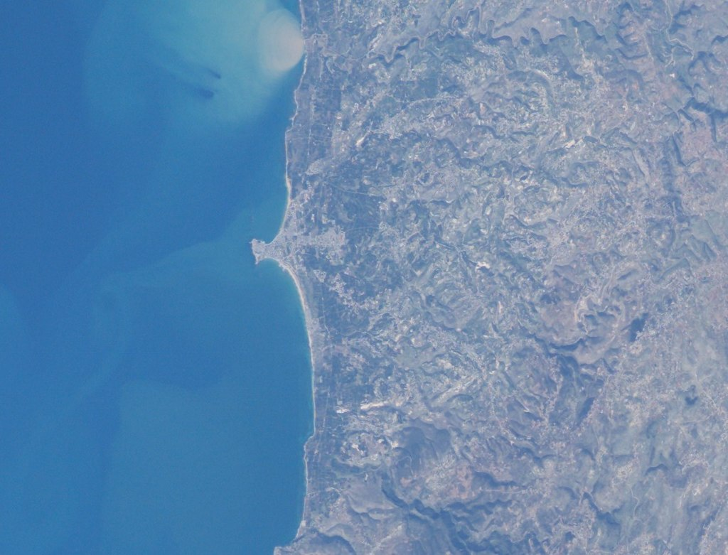

Slide 5
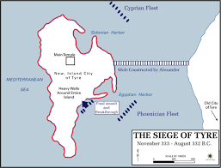

Slide 6
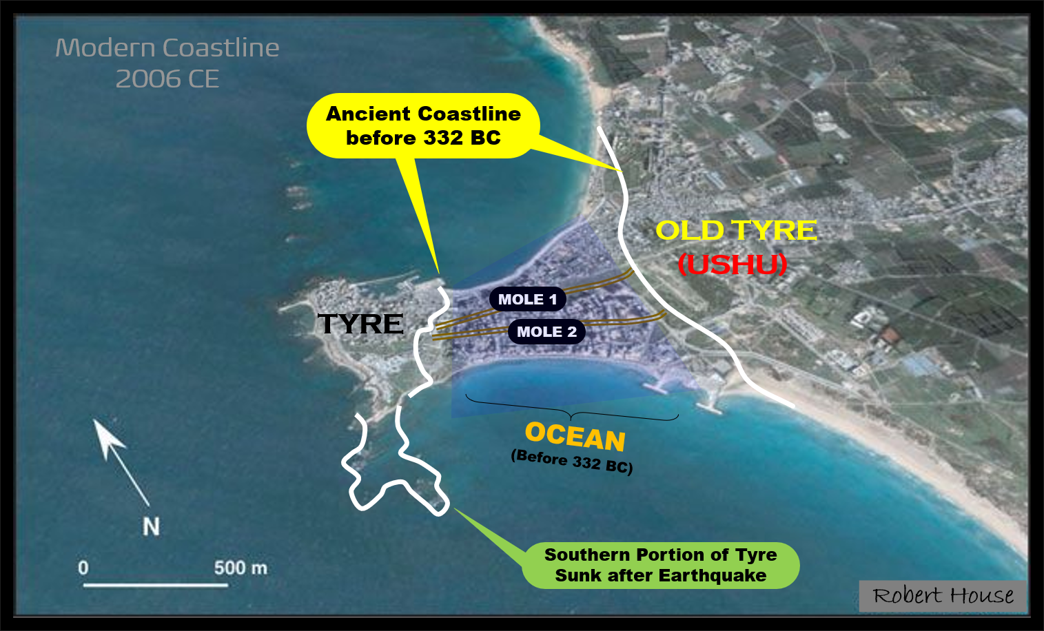

Slide 8
NATIONAL PROPHECIES:
(DAN. 2:31-45) – 604 B.C.
(EZEK. 26:3-21) – TYRE (590 B.C.)
(EZEK. 28:20-23) – SIDON

Slide 9
NATIONAL PROPHECIES:
(DAN. 2:31-45) – 604 B.C.
(EZEK. 26:3-21) – TYRE (590 B.C.)
(EZEK. 28:20-23) – SIDON
(IS. 13:19; 14:23) (JER. 51:26, 43) – BABYLON

